Slide 1
Machine Learning DASC 522
Neural Network Resampling
Dr. Torrey Wagner

Slide 2
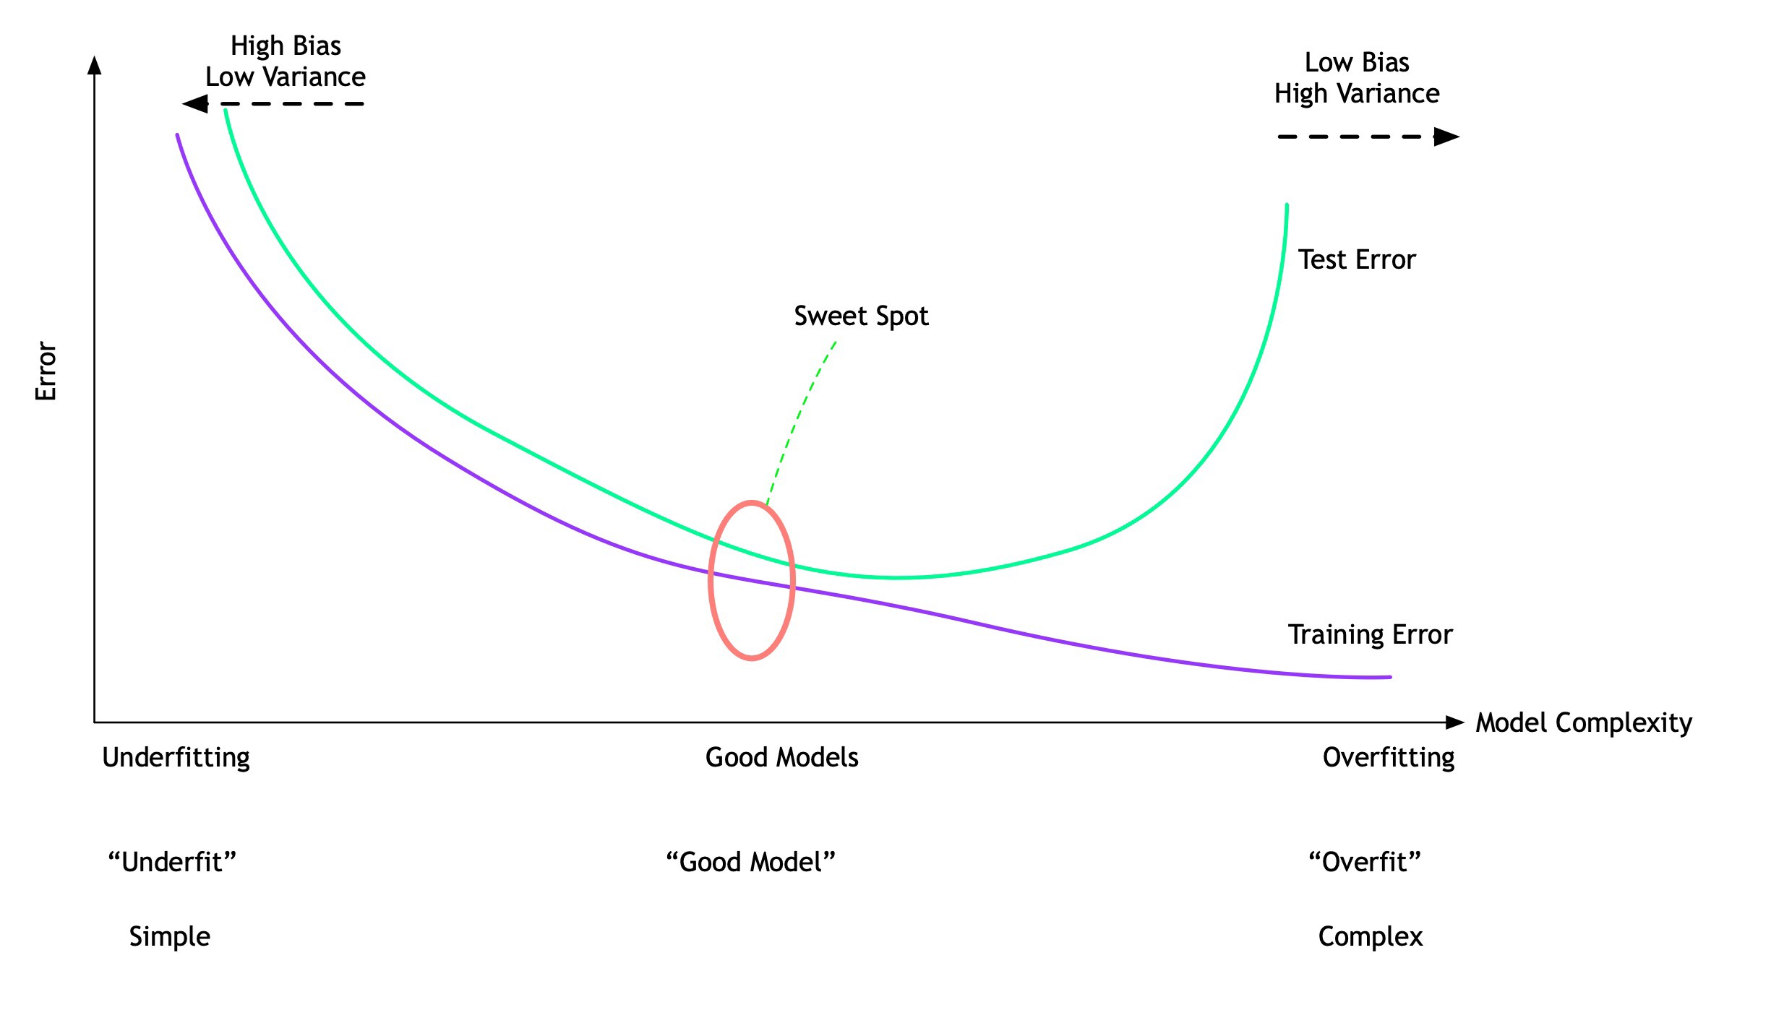
Resampling Overview
https://stats.stackexchange.com/questions/410118/cross-validation-vs-train-validation-test/410206
https://towardsdatascience.com/data-science-simplified-part-12-resampling-methods-e029db77fa9c
https://www.sciencedirect.com/science/article/pii/S1005030219301343

Slide 3
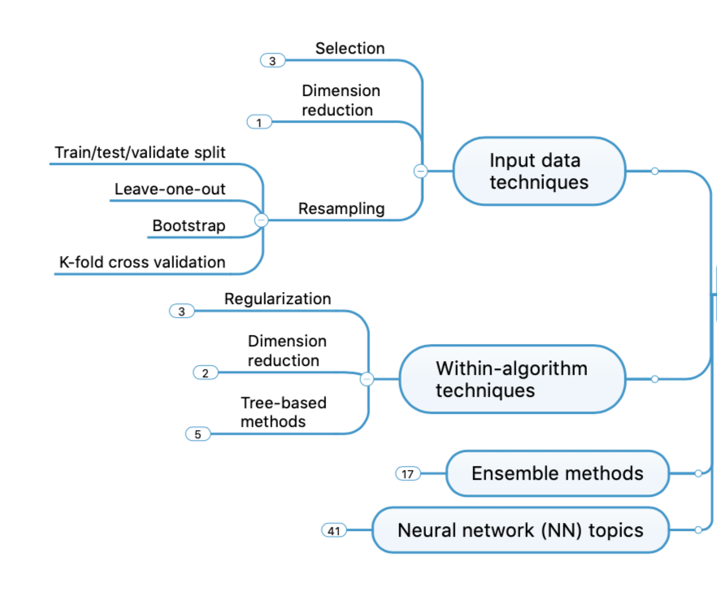
Concept Map - NN

Slide 4
Overview
Bootstrap (not covered)
Train-Validate Datasets
Leave-One-Out Cross Validation
K-fold Cross Validation
Cross Validation Examples
Python Demonstration

Slide 5
Overview
Train-Validate Datasets
Leave-One-Out Cross Validation
K-fold Cross Validation
Cross Validation Examples
Python Demonstration

Slide 6
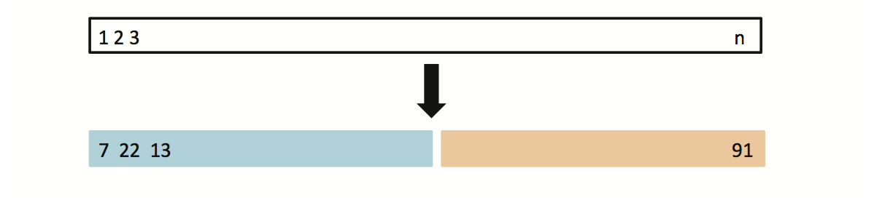
Validation Set Approach
Suppose that we would like to find a set of variables that give the lowest test (not training) error rate
If we have a large data set, we can achieve this goal by randomly splitting the data into training and validation(testing) parts
We would then use the training part to build each possible model (i.e. the different combinations of variables) and choose the model that gave the lowest error rate when applied to the validation data
Training Data
Testing Data
Slide from https://www.alsharif.info/iom530

Slide 7
Example: Auto Data
Suppose that we want to predict mpg from horsepower
Two models:
mpg ~ horsepower
mpg ~ horsepower + horspower²
Which model gives a better fit?
Randomly split Auto data set into training (196 obs.) and validation data (196 obs.)
Fit both models using the training data set
Then, evaluate both models using the validation data set
The model with the lowest validation (testing) MSE is the winner!
Slide from https://www.alsharif.info/iom530

Slide 8
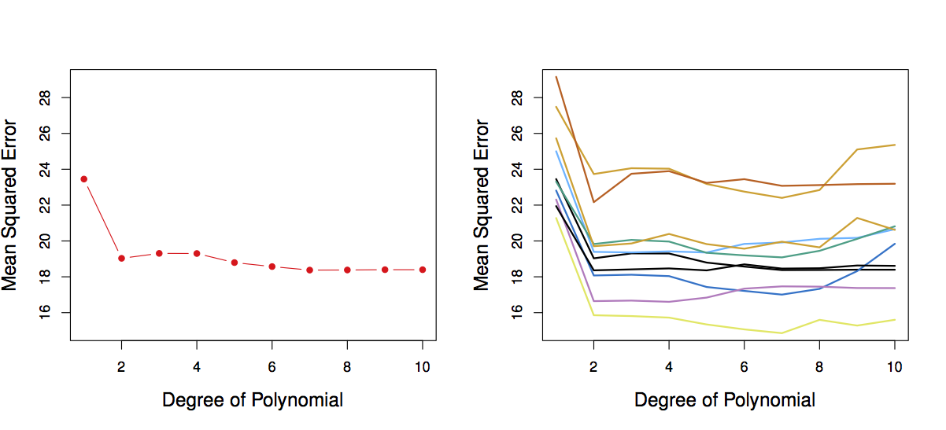
Results: Auto Data
Left: Validation error rate for a single split
Right: Validation method repeated 10 times, each time the split is done randomly!
There is a lot of variability among the MSE’s… Not good! We need more stable methods!
Slide from https://www.alsharif.info/iom530

Slide 9
The Validation Set Approach
Advantages:
Simple
Easy to implement
Easy to understand
Disadvantages:
The validation MSE can be highly variable
Only a subset of observations are used to fit the model (training data). Statistical methods tend to perform worse when trained on fewer observations
Requires a lot of data – data can be expensive
Problem is compounded for rare classification
Slide modified from https://www.alsharif.info/iom530

Slide 10
Overview
Train-Validate Datasets
Leave-One-Out Cross Validation
K-fold Cross Validation
Cross Validation Examples
Python Demonstration

Slide 11
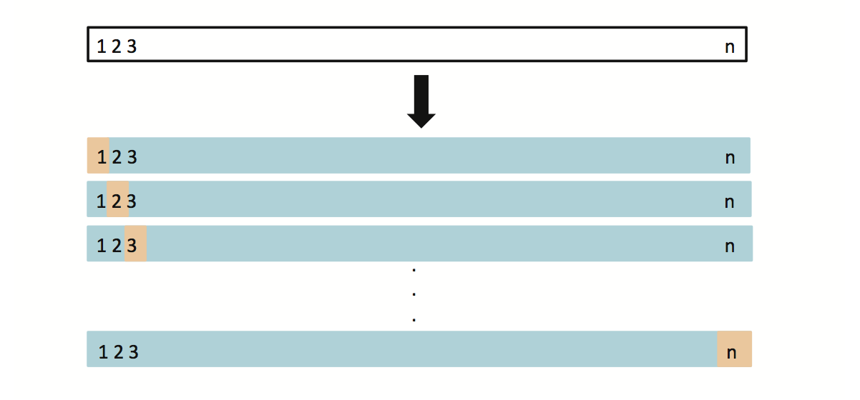
5.1.2 Leave-One-Out Cross Validation (LOOCV)
This method is similar to the Validation Set Approach, but it tries to address the latter’s disadvantages
For each suggested model, do:
Split the data set of size n into
Training data set (blue) size: n -1
Validation data set (beige) size: 1
Fit the model using the training data
Validate model using the validation data, and compute the corresponding MSE
Repeat this process n times
The MSE for the model is computed as follows:
Slide from https://www.alsharif.info/iom530

Slide 12
LOOCV vs. the Validation Set Approach
LOOCV has less bias
We repeatedly fit the statistical learning method using training data that contains n-1 obs., i.e. almost all the data set is used
LOOCV produces a less variable MSE
The validation approach produces different MSE when applied repeatedly due to randomness in the splitting process, while performing LOOCV multiple times will always yield the same results, because we split based on 1 obs. each time
LOOCV is computationally intensive (disadvantage)
We fit the each model n times!
Slide from https://www.alsharif.info/iom530 graphic from https://www.r-bloggers.com/2019/10/evaluating-model-performance-by-building-cross-validation-from-scratch/

Slide 13
Overview
Train-Validate Datasets
Leave-One-Out Cross Validation
K-fold Cross Validation
Cross Validation Examples
Python Demonstration

Slide 14
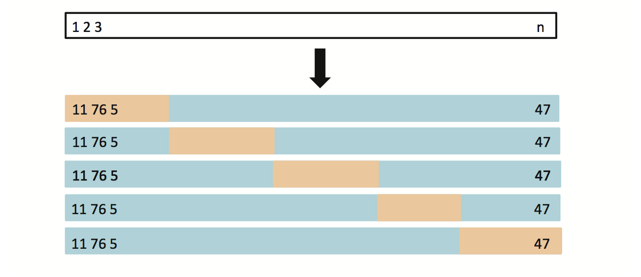
5.1.3 k-fold Cross Validation
LOOCV is computationally intensive, so we can run k-fold Cross Validation instead
With k-fold Cross Validation, we divide the data set into K different parts (e.g. K = 5, or K = 10, etc.)
We then remove the first part, fit the model on the remaining K-1 parts, and see how good the predictions are on the left out part (i.e. compute the MSE on the first part)
Average the Error(K) to get the error rate
Slide from https://www.alsharif.info/iom530

Slide 15
K-fold Cross Validation
Slide from https://www.alsharif.info/iom530

Slide 16
Overview
Train-Validate Datasets
Leave-One-Out Cross Validation
K-fold Cross Validation
Cross Validation Examples
Python Demonstration

Slide 17
Auto Data: LOOCV vs. K-fold CV
Left: LOOCV error curve
Middle: 10-fold CV was run many times, and the figure shows the slightly different CV error rates
Slide from https://www.alsharif.info/iom530

Slide 18
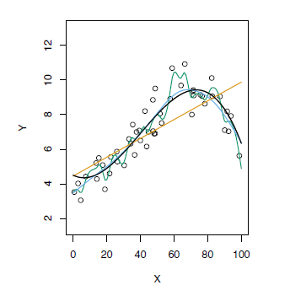
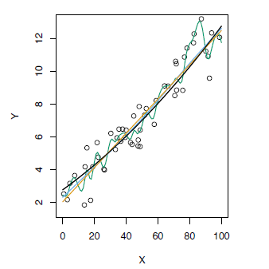
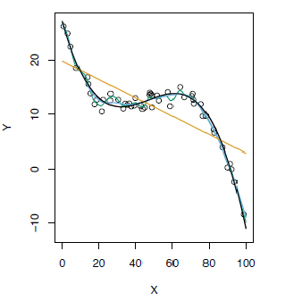
K-fold Cross Validation
Blue: True Test MSE
Black: LOOCV MSE
Orange: 10-fold MSE
Refer to chapter 2 for the top graphs, Fig 2.9, 2.10, and 2.11
Slide from https://www.alsharif.info/iom530

Slide 19
Bias-Variance Trade-off for k-fold CV
Putting aside that LOOCV is more computationally intensive than k-fold CV… Which is better LOOCV or K-fold CV?
LOOCV is less bias than k-fold CV (when k < n)
But, LOOCV has higher variance than k-fold CV Thus, there is a trade-off between what to use
Conclusion:
We tend to use k-fold CV with K = 5 or K = 10
It has been empirically shown that 5 or 10 yield test error rate estimates that suffer neither from excessively high bias, nor from very high variance
Slide from https://www.alsharif.info/iom530, graphic from https://www.linkedin.com/pulse/explaining-bias-variance-tradeoff-terms-whack-a-mole-alex-nelson

Slide 20
CV to Choose the Order
Logistic Regression
KNN
Brown: Test Error
Blue: Training Error
Black: 10-fold CV Error
Slide from https://www.alsharif.info/iom530

Slide 21
Overview
Train-Validate Datasets
Leave-One-Out Cross Validation
K-fold Cross Validation
Cross Validation Examples
Python Demonstration

Slide 22
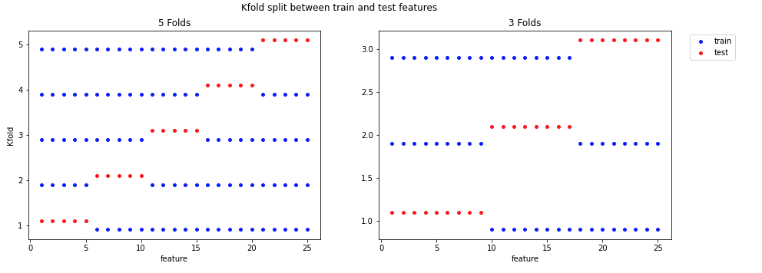
Python Demonstration

